Slide 1

Year 6 SATs 2026

Slide 2
What are the SATs?
SATs are the Standardised Assessment Tests that are given to children at the end of Key Stage 2.
The SATs take place over four days, starting on Monday 11th May ending on Thursday 14th May.
The SATs papers consist of:
Spelling, punctuation and grammar (paper 1: Grammar/ Punctuation/ Spelling) – Monday 11th May
Spelling, punctuation and grammar (paper 2: Spelling test) – Monday 11th May
Reading – Tuesday 12th May
Maths (paper 1: Arithmetic) – Wednesday 13th May
Maths (paper 2: Reasoning) – Wednesday 13th May
Maths (paper 3: Reasoning) – Thursday 14th May
Writing is assessed using evidence collected throughout Year 6. There is no Year 6 SATs writing test.
The key stage 2 tests will be taken on set dates unless your child is absent, in which case they may be able to take them up to 5 school days afterwards.

Slide 3
When and how the SATs are completed
The tests take place during normal school hours, under exam conditions.
Children are not allowed to talk to each other from the moment the assessments are handed out until they are collected at the end of the test.
After the tests are completed, the papers are sent away to be marked externally.
The results are then sent to the school in July.
Each test lasts no longer than 60 minutes:
Spelling, punctuation and grammar (paper 1: Grammar/ Punctuation) – 45 minutes
Spelling, punctuation and grammar (paper 2: Spelling) – 20 minutes (approximately)
Reading – 60 minutes
Maths (paper 1: Arithmetic) – 30 minutes
Maths (paper 2: Reasoning) – 40 minutes
Maths (paper 3: Reasoning) – 40 minutes

Slide 4
Specific arrangements for SATs
Children with additional needs (who have similar support as part of day-to-day learning in school) may be allotted specific arrangements, including:
Additional (extra) time;
Tests being opened early to be modified;
An adult to scribe (write) for them;
Using word processors independently;
An adult to read for them (including a translator);
The use of prompts or rest breaks;
Arrangements for children who are ill or injured at the time of the tests.
Pupils with an EHCP are automatically allowed up to 25% additional time (except for the spelling paper, which is not strictly timed).
Pupils who use the modified large print or braille versions of the tests are automatically allowed up to 100% additional time.
We will apply for anything and everything to meet each child’s needs

Slide 5
Spelling, Punctuation and Grammar: Monday 11th May
Spelling, Punctuation and Grammar consists of two papers.
Paper 1 focuses on all three elements (spelling, punctuation and grammar). The paper lasts for 45 minutes.
Paper 2 consists of a spelling test only. It should take approximately 20 minutes, although this is not a set amount of time (pupils should be given as much time as they need to complete the test).

Slide 6
Spelling, Punctuation and Grammar: Paper 1
The children will have been working hard with their class teacher on developing and securing their knowledge of the technical vocabulary needed in this test.
This test focuses on:
Grammatical terms/ word classes;
Functions of sentences;
Combining words, phrases and clauses;
Verb forms, tenses and consistency;
Punctuation;
Vocabulary;
Standard English and formality.
This test requires a range of answer types but does not require longer formal answers.

Slide 7
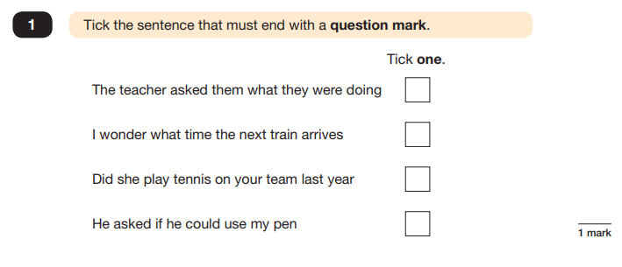
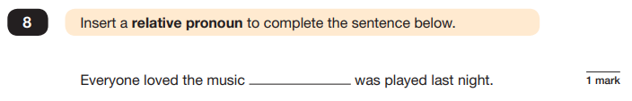
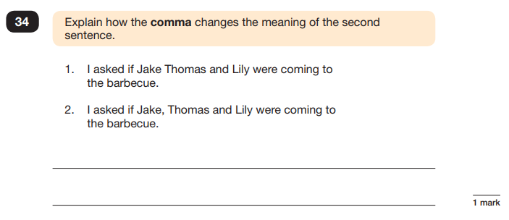
Spelling, Punctuation and Grammar: Paper 1
Example questions:
e.g. that, which
✓
e.g. The first sentence is about two people and the second sentence is about three people.

Slide 8
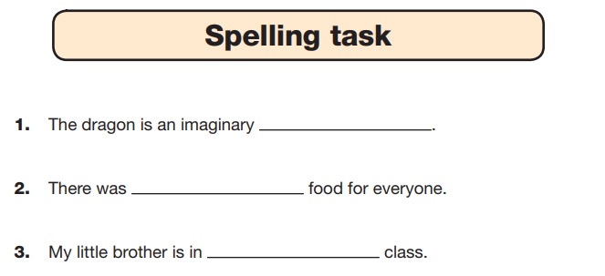
Spelling, Punctuation and Grammar: Paper 2
Paper 2 is a shorter paper that focuses solely on spellings.
Example questions:

Slide 9
Reading: Tuesday 12th May
There is one reading test that lasts for 60 minutes.
The test is designed to measure if the children’s comprehension of age-appropriate reading material meets the national standard. There are three different set texts for children to read. These could be any combination of non-fiction, fiction and/ or poetry.
The test covers the following areas (known as Content Domains):
Give/ explain the meaning of words in context;
Retrieve and record information/ identify key details from fiction and non-fiction;
Summarise main ideas from more than one paragraph;
Make inferences from the text/ explain and justify inferences with evidence from the text;
Predict what might happen from details stated and implied;
Identify/ explain how information/ narrative content is related and contributes to meaning as a whole;
Identify/ explain how meaning is enhanced through choice of words and phrases;
Make comparisons within the text.

Slide 10
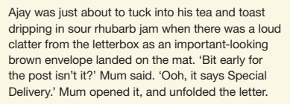
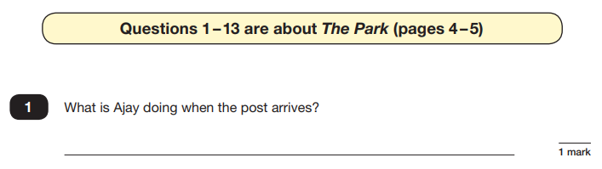
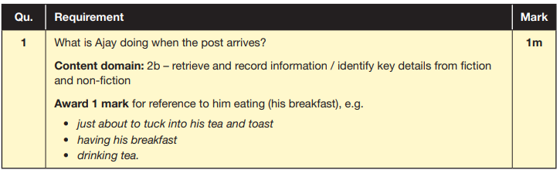
Reading
The reading SATs paper requires a range of answer styles.
Example questions:

Slide 11
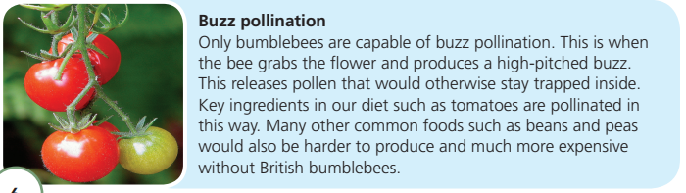
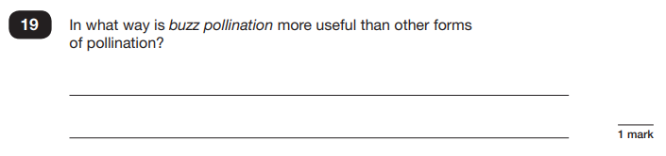
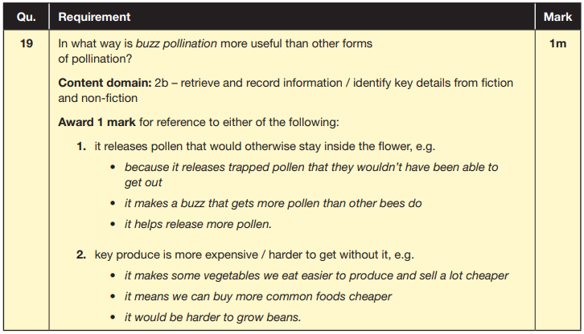
Reading
Example questions:
Based on text 2: Fact Sheet: About Bumblebees

Slide 12
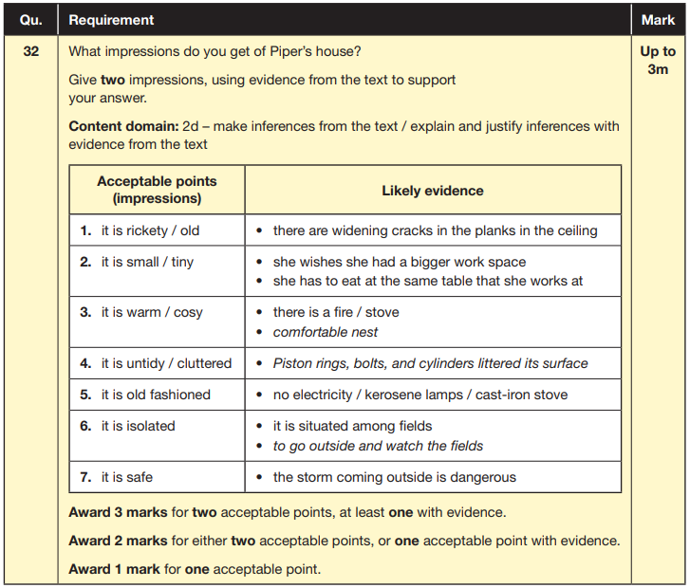
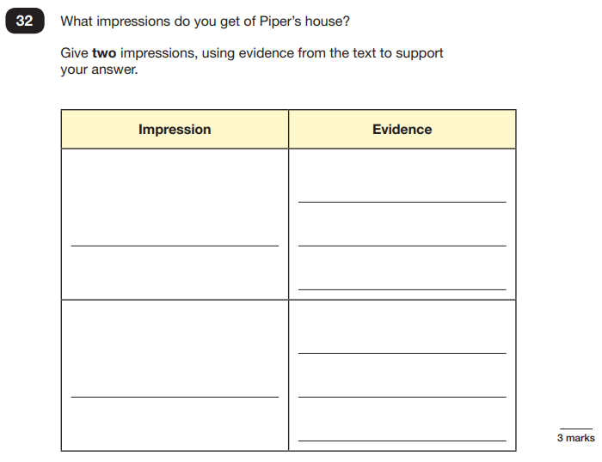
Reading
Example questions:
Based on text 3: Music Box

Slide 13
Reading
Since the current testing formation for the SATs began in 2016, there has been a tendency for three types of questions to be the most popular.
As an example, In the 2019 Reading SATs paper,
12% of marks could be gained from answering questions involving giving and explaining the meaning of words in context;
42% of marks could be gained from answering questions involving retrieving and recording information or identifying key details from a text;
36% of marks could be gained from answering questions involving making inferences from a text and justifying inferences with text evidence.
When reading with your child at home try focusing on these types of questions.

Slide 14
Maths: Wednesday 13th and Thursday 14th MAy
The maths assessments consist of three tests.
Paper 1: Arithmetic (30 minutes) – Wednesday 13th May
Paper 2: Reasoning (40 minutes) – Wednesday 13th May
Paper 3: Reasoning (40 minutes) – Thursday 14th May

Slide 15
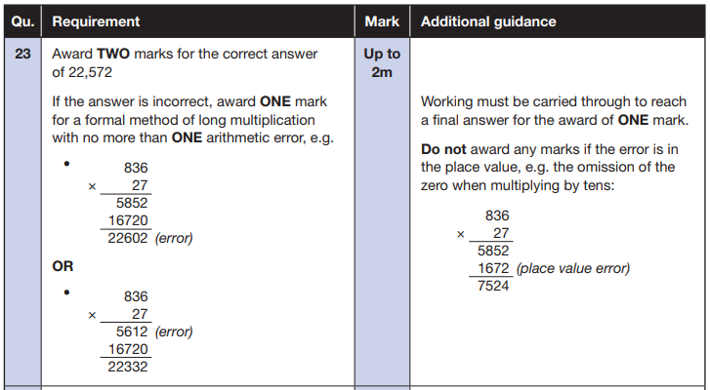
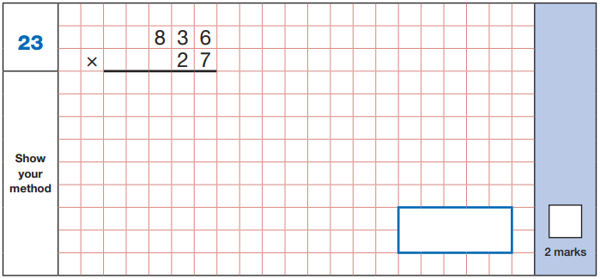
Maths Paper 1 (Arithmetic)
The maths arithmetic paper has a total of 40 marks.
The test covers the four operations (addition, subtraction, multiplication, division, including order of operations requiring BIDMAS), percentages of amounts and calculating with decimals and fractions.
Example question:

Slide 16
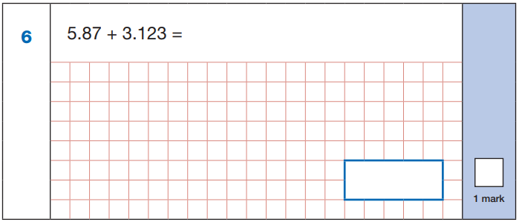
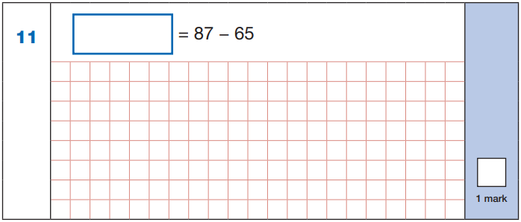

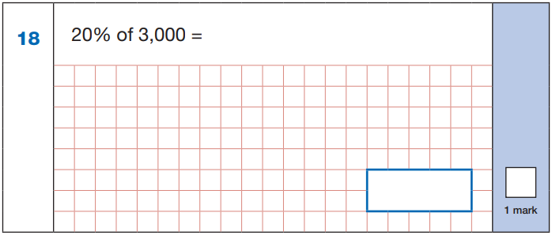
Maths Paper 1 (Arithmetic)
Example questions:
22
5.87
+ 3.123
8.993
87
- 65
22
8.993
60 ÷ (30 - 24)
60 ÷ 6 = 10
10% of 3,000 = 300
20% of 3,000 = 600
10
600

Slide 17
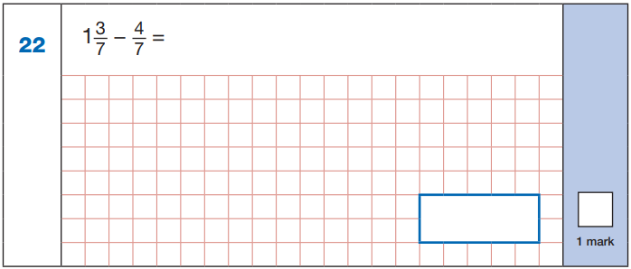
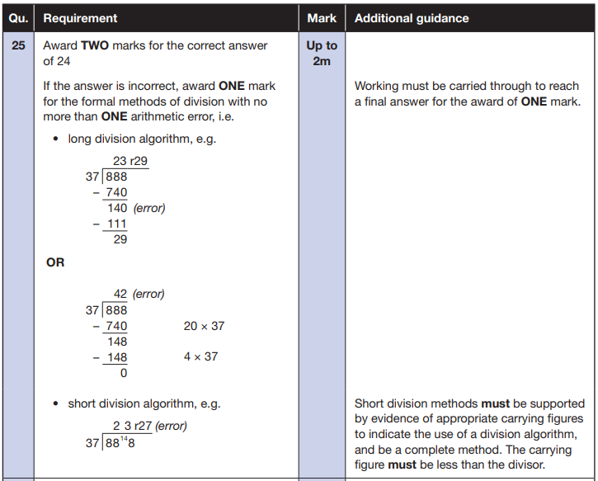
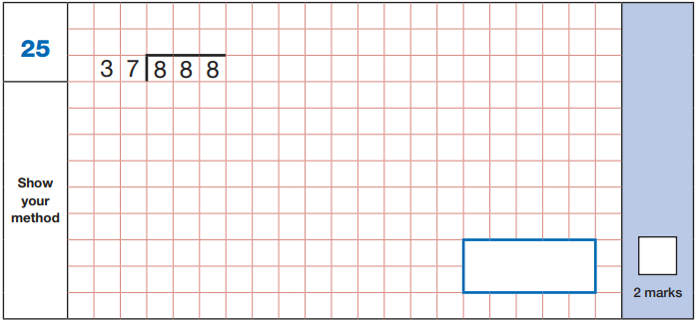


Maths Paper 1 (Arithmetic)
Example questions:
$\frac{\text{10}}{\text{7}}$ - $\frac{\text{4}}{\text{7}}$ = $\frac{\text{6}}{\text{7}}$
$\frac{\text{6}}{\text{7}}$

Slide 18
Maths Papers 2 and 3 (Reasoning)
Paper 2 will take place on Wednesday 13th May and paper 3 will take place on Thursday 14th May. These tests have a total of 35 marks each.
These papers require children to demonstrate their mathematical knowledge and skills, as well as their ability to solve problems and their mathematical reasoning. They cover a wide range of mathematical topics from key stage 2 including,
Number and place value (including Roman numerals);
The four operations;
Geometry (properties of shape, position and direction);
Statistics;
Measurement (length, perimeter, mass, volume, time, money);
Algebra;
Ratio and proportion;
Fractions, decimals and percentages.

Slide 19
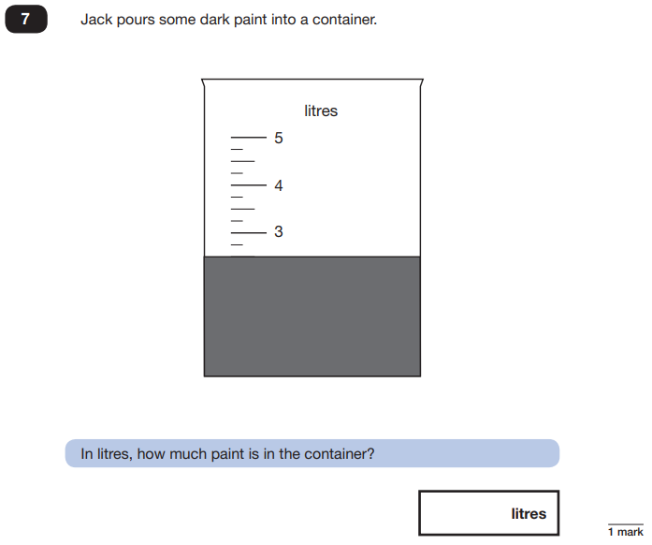
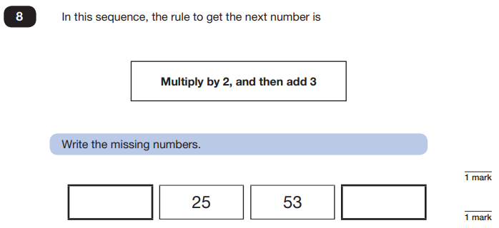
Maths Papers 2 (Reasoning)
Example questions:
11
109
2.5 or 2 ½

Slide 20
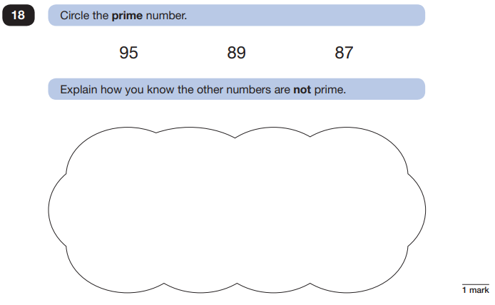
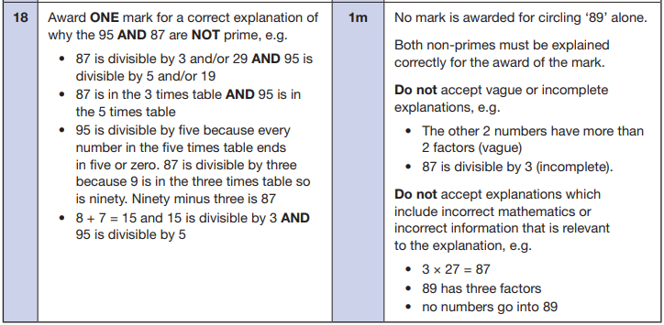
Maths Papers 2 (Reasoning)
Example question:

Slide 21
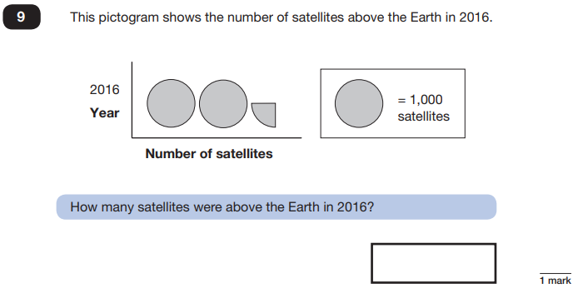
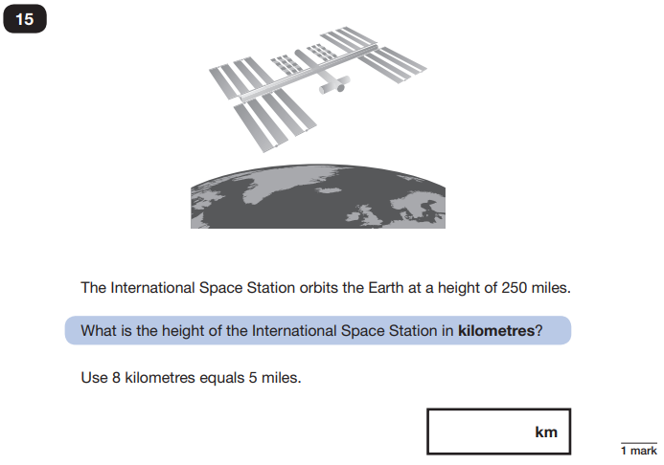
Maths Papers 3 (Reasoning)
Example questions:
2,250
400

Slide 22
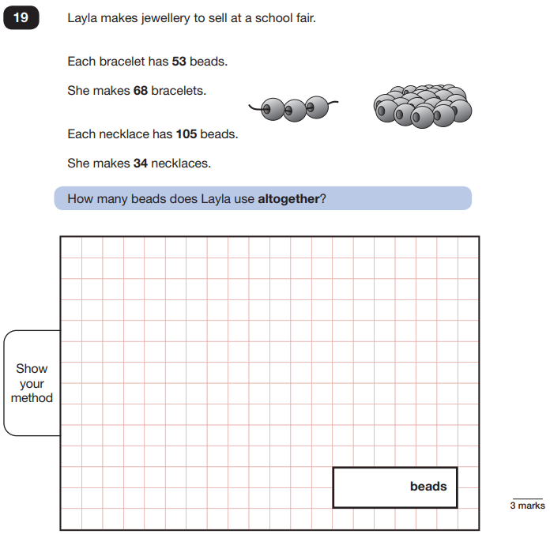
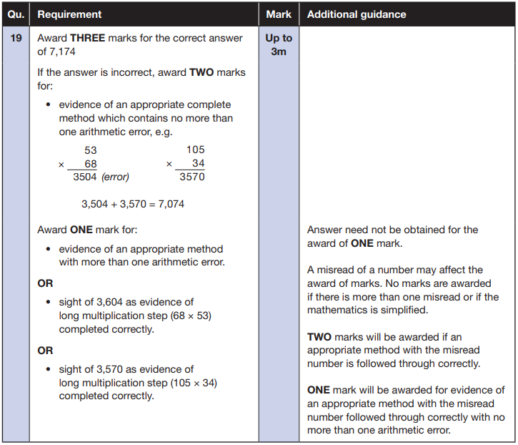
Maths Papers 3 (Reasoning)
Example question:

Slide 23
What can you do at home to help?
Tips:
Work on times tables so that the answers are immediate (not counting on their fingers or taking a long time to recite the answer.
Reading little and often – 10-15 minutes a day. There are 3 texts and they are quite lengthy so reading stamina is key.
Don’t overdo it at home. Please don’t spend hours and hours per day at home revising for these tests.
Look and use the printout – there are lots of valuable things that can be done at home on here.
Please, please, please make sure your child has had breakfast the morning of each test. We offer a SATs breakfast club Monday-Thursday of SATS week.

Slide 24
Things to remember about SATs
SATs focus on what children know about Maths and English.
They will not reflect how talented they are at science, geography, art, PE…, and they certainly won’t highlight all of their amazing personal characteristics.
SATs don’t tell the whole story.
Their results will say if they did or did not meet a certain standard but not necessarily by what margin. These thresholds change each year according to the overall national performance, so what was classed as ‘meeting the expected standard’ this year might not be the same as last year.
SATs are only four days out of a whole Primary School career.
In reality, there’s one or two papers each day that last 30 to 60 minutes.

Slide 25
Clear message for us…
See each test as a challenge to get stuck into
Do the best you possibly can – if you walk away from each test knowing you did your absolute best then your family and teachers will be proud of you.
At the end, please take home a handout which has useful websites/information that can be done at home.

