Slide 1

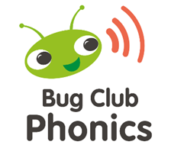
Supporting
your child with
Phonics and Reading

Slide 2
Aims
To share how phonics is taught at King Ina Academy.
To teach the basics of phonics and some useful terms.
To develop confidence in helping your child with phonics and reading.

Slide 3
As a school we follow the Bug Club Phonics scheme.
This is a synthetic phonics framework that is approved by the Department for Education.
It sets out a suggested scheme of teaching children the sounds and the letters of the alphabet in order to segment and blend.
These are the necessary skills required to decode words to read and write.
Bug Club Phonics starts in Phase one which begins in Nursery and progresses through Key Stage 1 until all Phases are complete (1-6).

Slide 4
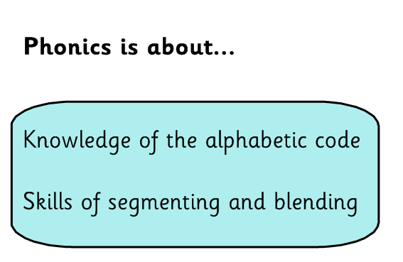

Slide 5
Terms your child will learn
Digraph: Two letters that make one sound when read.
Trigraph: Three letters that make one sound.
Segmenting: is breaking up a word into its sounds.
Blending: Putting the sounds together to read a word
Tricky words: Words that cannot be decoded. We learn these from sight as a whole word.
Alien word/Nonsense word: Words that are not real.

Slide 6
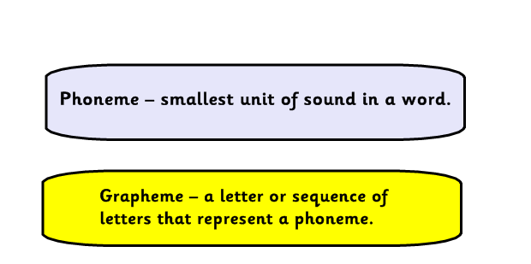

Slide 7
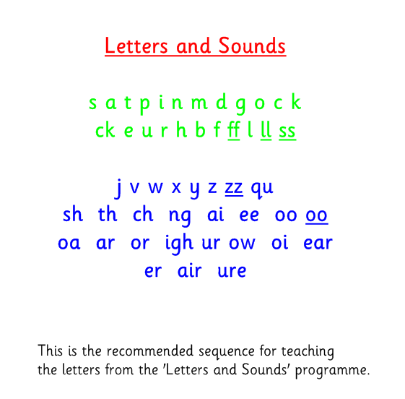
Notes:
Add in you tube clip for enunciation

Slide 8
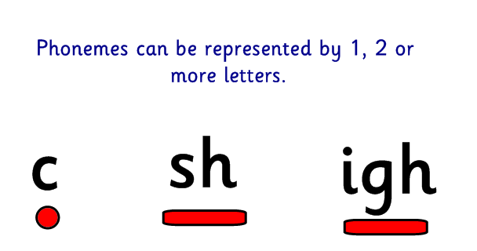
Notes:
Phonemes = Sounds

Slide 9
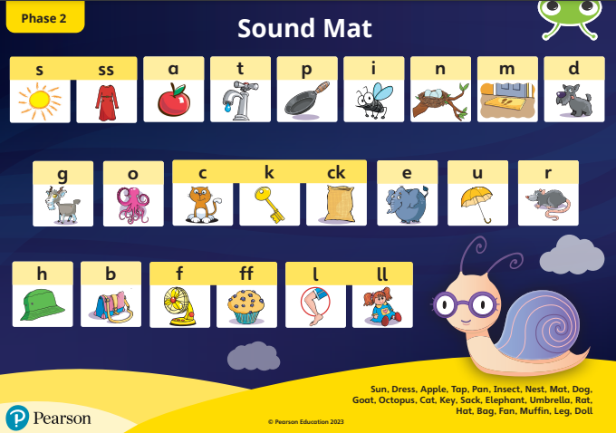

Slide 10
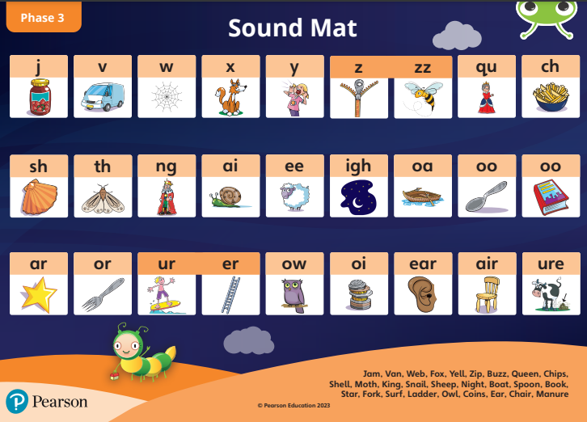

Slide 11
Sounds should be articulated clearly and precisely
https://www.youtube.com/watch?v=UCI2mu7URBc&t=4s
Notes:
Try not to add uh to sounds such as ‘suh’ ‘muh’ try and keep the sounds pure and short.

Slide 12
Phonics Bug Club
is taught through 6 phases
from Nursery to Year 2
Phase 1: Explores environmental sounds and how sounds are produced.
Phase 2: Introduces the first 19 phonemes
Phase 3: Explores the next 26 phonemes
Phase 4: Consolidation unit where we explore blending, and segmenting .
Phase 5: Explores alternative pronunciations of graphemes
Phase 6 : Consolidation of all previously taught phonemes
For more information please refer to the Phonics Bug Club Guidance

Slide 13
How is Phonics taught in School?
Every day the children have a 20-25 minute session of phonics.
• Fast paced approach.
Lessons include a range of reading, spelling and writing.
We build upon this knowledge throughout the school day.
Additional interventions are provided for pupils.

Slide 14
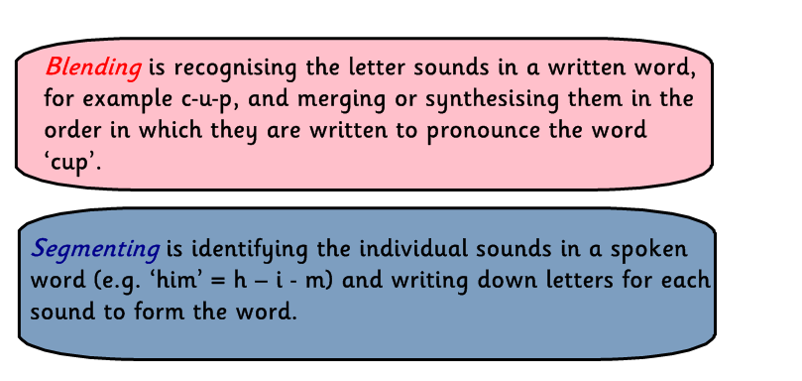
Your child will learn to use the terms:
Children need to be able to hear the separate sounds in a word and then blend them together to say the whole word .

Slide 15
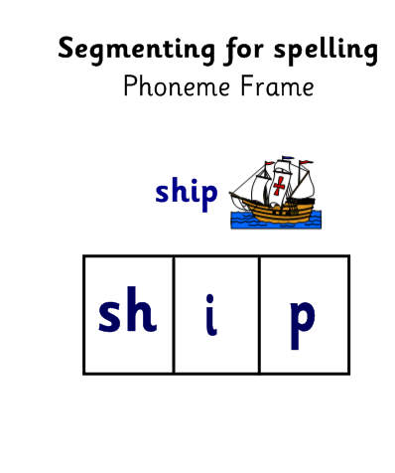

Robot Arms

Slide 16

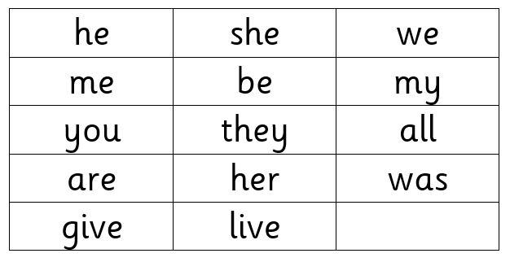
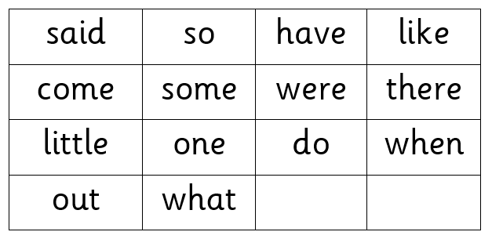
Tricky Words
Words that cannot be sounded out. We learn these words from sight.

Slide 17


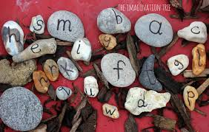
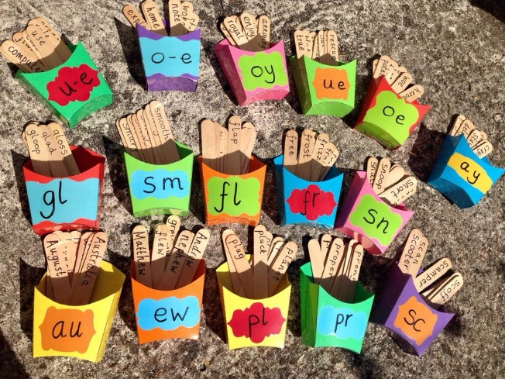
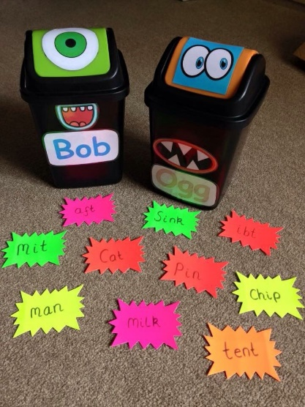
How can I help at home?

Slide 18
Make it Fun!
Most children learn best when they are doing something for a real purpose and because they want to, so playing games is an easy way to support their learning.

Slide 19


Practise the sounds
and tricky words together.
Use them to make different words at home and play phonics games.
Read everyday with your child if possible.
Notes:
Comprehension and bedtime stories – sound spotting
Review as a sentence once decoded to ensure comprehension

Slide 20

Home Reading
In your child’s book bag you will find :
Reading record book.
Reading book.
Home learning wallet that includes taught sounds and tricky words.
Bug club login and password.

Slide 21

Notes:
Email/ Speak to class teacher

