Slide 1
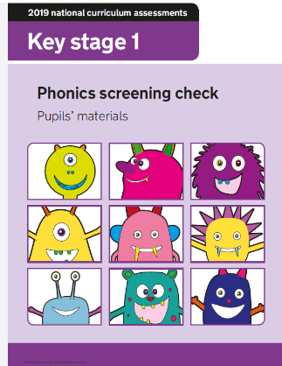

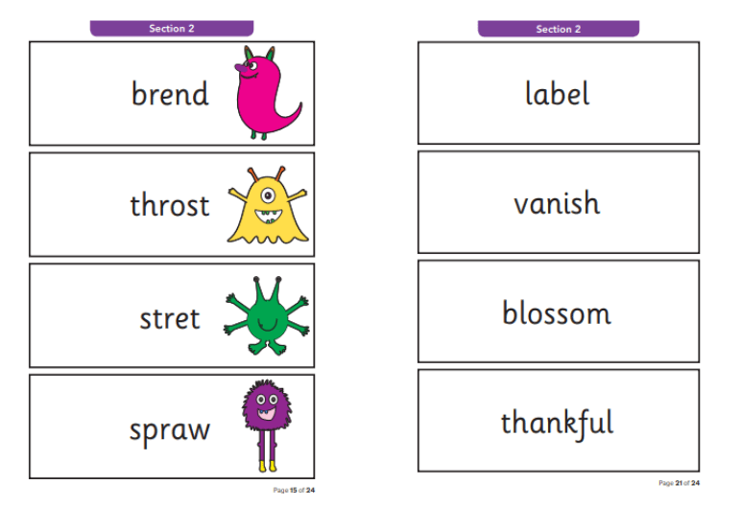
Year One Phonics Screening Information Evening
Presented by Mrs Jackie Slade Phonics Subject Leader
Thursday 27th April 2023

Slide 2

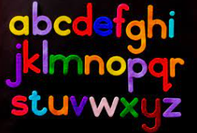
The Year One Screening Check
Is an informal test to help teachers ensure children are making sufficient progress in their phonics skills to read words and that they are on track to become fluent readers who can enjoy reading for pleasure and for learning.
The phonics screening check is taken individually by all children in Year 1 in England, and is usually taken in June. It is designed to give teachers and parents information on how your child is progressing in phonics. It will help to identify whether your child needs additional support at this stage so that they do not fall behind in this vital early reading skill.

Slide 3
What is in the Screening Check?
There are two sections in this 40-word check and it assesses phonics skills and knowledge learned through Reception and Year 1. Your child will read up to four words per page for their teacher and they will probably do the check in one sitting of about 5–10 minutes.
What sort of check is it and is it compulsory?
It is a school-based check to make sure that your child receives any additional support promptly, should they need it. It is not a stressful situation as the teacher will be well-equipped to listen and understand your child’s level of skills.
There will be a few practice words first to make sure your child understands the activity.

Slide 4

What does it check?
It checks that your child can:
Sound out and blend graphemes in order to read simple words.
Read phonically decodable one-syllable and two-syllable words, e.g. cat, sand, windmill.
Read a selection of nonsense words which are referred to as alien words.
What are nonsense or alien words and why are they included?
These are words that are phonically decodable but are not actual words with an associated meaning e.g. brip, snorb. Alien words are included in the check specifically to assess whether your child can decode a word using phonics skills and not their memory.
The alien words will be shown to your child with a picture of a alien and they will be asked to tell their teacher what sort of alien it is by reading the word. This not only makes the check a bit more fun, but provides the children with a context for the nonsense word which is independent from any existing vocabulary they may have. Crucially, it does not provide any clues, so your child just has to be able to decode it. Children generally find nonsense amusing so they will probably enjoy reading these words

Slide 5
How will my child be scored? Is there a pass mark?
The check is not about passing or failing but checking appropriate progress is
being made. If children do not reach the required standard, then the teacher will be in touch to discuss plans and offer additional, tailored support to ensure that your child can catch up. Children progress at different speeds so not reaching the threshold score does not necessarily mean there is a serious problem. Your child will re-sit the check the following summer term.
For the last few years, the threshold mark (or pass standard) set by the government has been 32 correct answers out of 40.
What should I do if my child is struggling to decode a word?
Say each sound in the word from left to right.
Blend the sounds by pointing to each letter, i.e. /b/ in bat, or letter group, i.e. /igh/ in sigh, as you say the sound, then run your finger under the whole word as you say it.
Talk about the meaning if your child does not understand the word they have read.
Work at your child’s pace.
Always be positive and give lots of praise and encouragement

Slide 6

Thank You for Listening
Questions are Welcome!

