Slide 1
Welcome to King Ina Academy

Slide 2
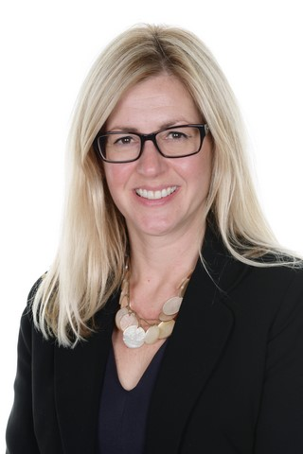
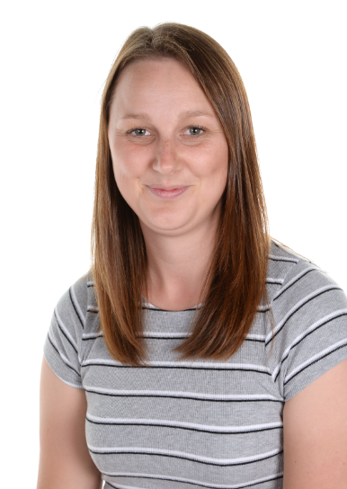
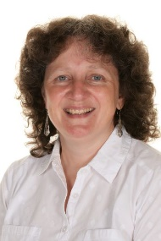
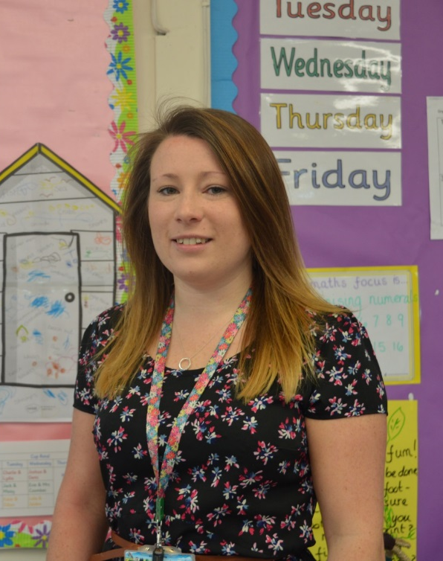
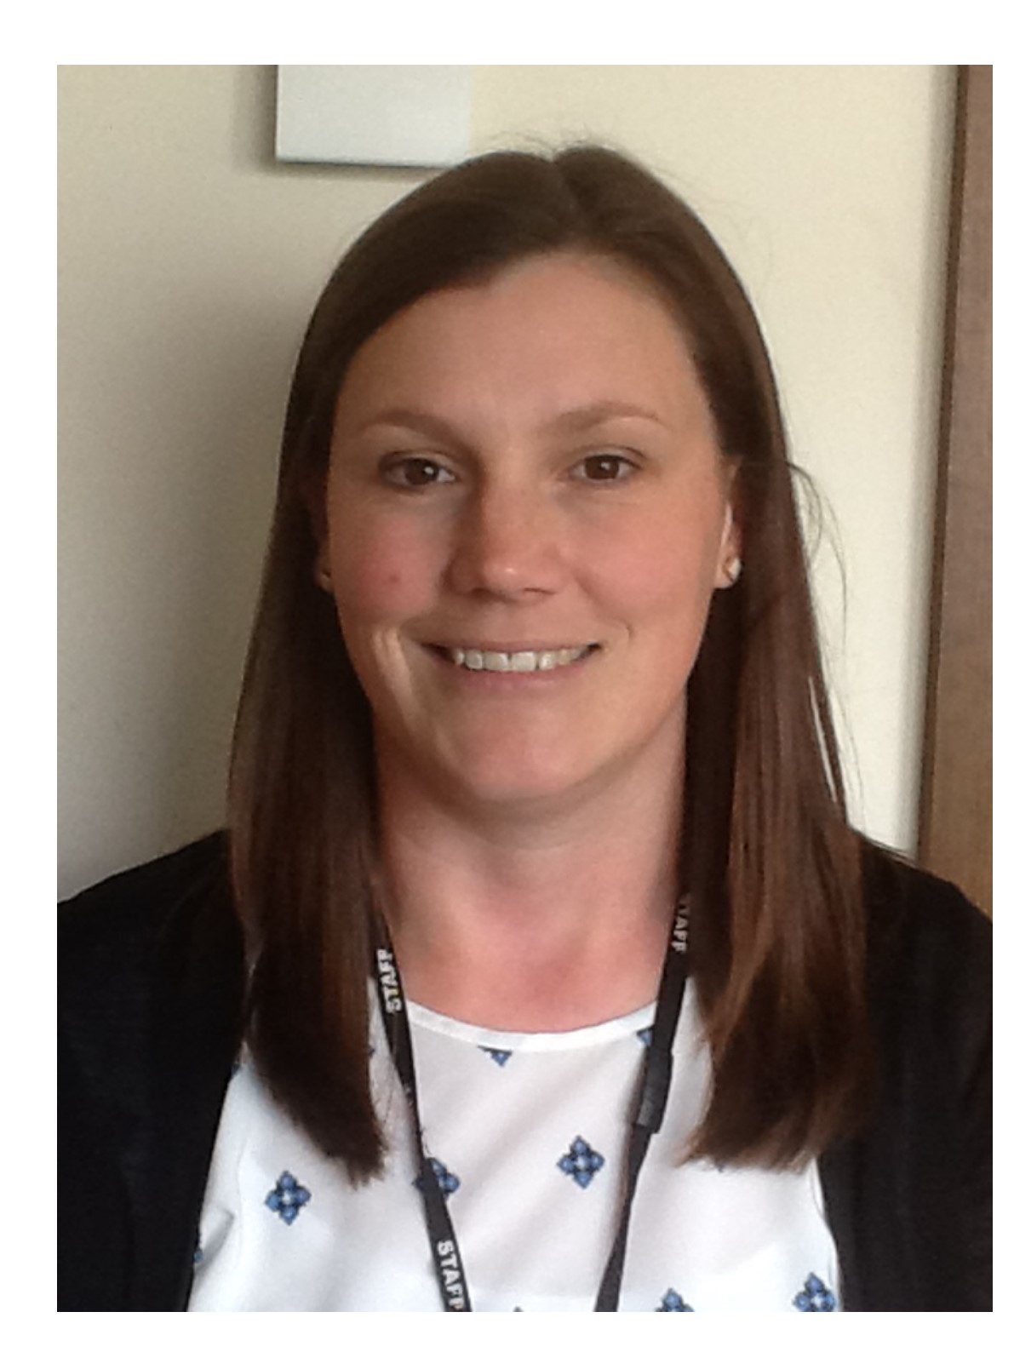
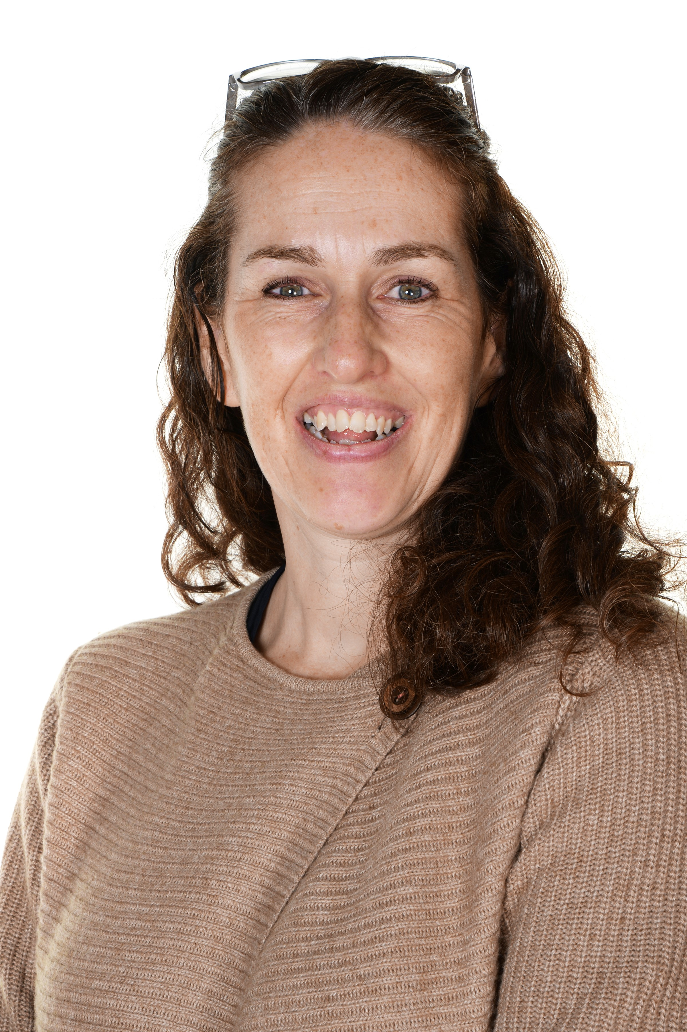
Who is Who?
Mrs Stock
Special Educational Needs Coordinator (SENCo)
Mrs Gay
Pipits
Class Teacher
Mrs Wills
Pipits
Class Teacher
Mrs Svenson Headteacher
Mrs Ruddle
Special Educational Needs Coordinator (SENCo)
Mrs Slade
Wagtails
Class Teacher
Mrs Salt
Deputy Headteacher

Slide 3
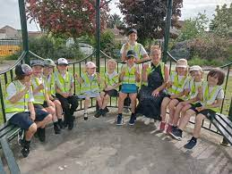
The Treehouse Somerton
Breakfast Club – Monday – Thursday 7:30am – 8:35am
Afterschool Club - Monday – Thursday 3:15pm -5:30pm
Contact Laura Pagano on:
thetreehousesomerton@gmail.com
Facebook Page – The Treehouse Somerton

Slide 4
Induction Programme
Dates | Times | Notes
Week 1 5th September 2024 (3rd and 4th INSET days) | 8.50am – 12pm | The children will be leaving school to go home for lunch.
Week 2 9th September 2024 | 8.50m – 1.15pm Includes lunch | The children will stay for lunch and go home afterwards.
Week 3 16th September 2024 | 8.50am – 3:15pm | Children attend school full time.
Weeks 4, 5, 6 & 7 . |  | Children attend school full time. If you wish to extend your child’s induction at this stage, speak to the class teacher to arrange this

Slide 5
Home Visits
Home visits are a great way for early years teachers, parents, and children to meet and talk in a relaxed and informal setting. They enable parents and carers to share information about their child and teachers to provide information about the setting.
Home visits are optional and will take place during the first 2 weeks in September whilst the children are settling into school.
If you would like to sign up for a home visit please add your name to our sign up sheet in the classrooms and we will be in contact in to arrange a suitable date and time.

Slide 6
The School Day – Foundation Stage
Morning 8:50am - 12noon
Break 10:45am - 11:00am
Lunch 12noon - 1:00pm
Afternoon 1:00pm - 3:15 pm

Slide 7
Reception Baseline Assessment (RBA)

Slide 8
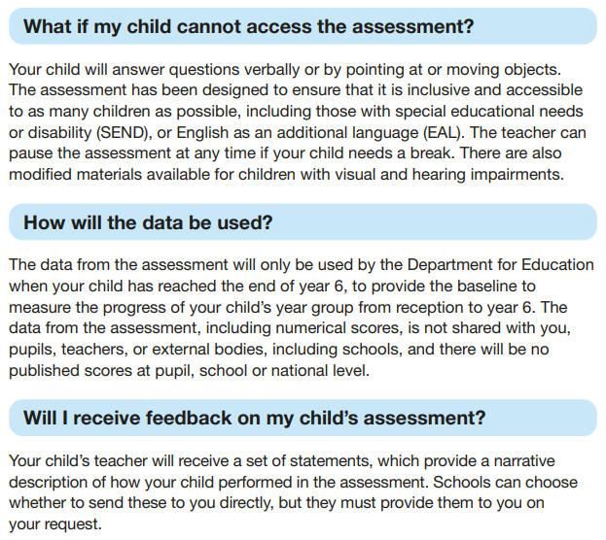
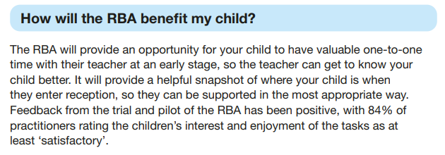

Slide 9
Parent Workshops
We are inviting parents to attend an evening of workshops to find out more about our teaching and recording in the Early Years Foundation Stage. These workshops will focus on:
Phonics – Our teaching and delivery of phonics and how you can support your child at home with their reading.
Social, Emotional & Mental Health – Emotion Coaching.
Class Dojo – Our parent communication platform for sharing learning and achievements.
These workshops will be delivered during an evening session on Wednesday 11th September 2024 at 5pm
more information to follow.

Slide 10
School Nurse Service
School readiness – YouTube
School Readiness Booklet
South Somerset School Nurse Team
Tel: 0300 3230114
Email: SouthSomersetSN@somerset.gov.uk

Slide 11
Paperwork
Data sheet
Everyone needs to complete a Universal Infant meals form (even if having packed lunch)
Parental Consent form
Please complete/check all of the above and return to the school office by the 4th of July 2024.
All about me sheets – To be completed with your child and returned in September.

Slide 12
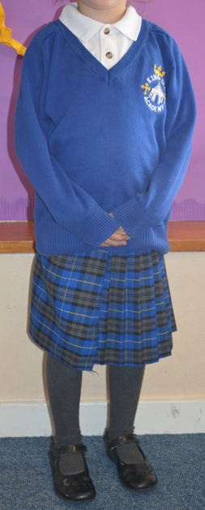
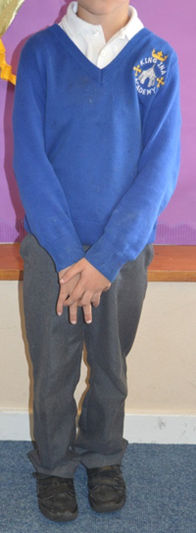
Uniform available from…..
Blouse/Shirt | White short-sleeved polo shirt* or white blouse or white shirt
Jumper/Cardigan | Royal blue V-necked knitted jumper* or knitted cardigan*
Skirts/Pinafore Dresses | School Tartan Kilts and pinafore dresses are available online from SW Schoolwear, or plain grey
Trousers/Shorts | Grey
Socks | White, dark grey or black
Tights | Grey or black
Shoes | Sensible, in black,
Dresses | Royal blue gingham check
School Tie (Optional) | Available from South West Schoolwear
P.E kit | Black or navy blue shorts, white ‘T’ Shirts, plimsolls (‘daps’)/trainers, (optional royal blue PE Hoodies available from SW Schoolwear.
* Available with school logo online from…
www.myclothing.com – Order from Tesco online
www.swschoolwear.co.uk – Order online or in the School Wear shop in Yeovil

Slide 13
Transition Dates
Story and Craft Sessions:
Transfer Day
Wednesday 3rd July 9:30-11 to come and spend time in their class with their class teacher and peers without a parent/carer.
Monday 17th June | 9:30am-10:30am
Tuesday 18th June | 10am-11am
Thursday 20th June | 1:30pm-2:30pm
Monday 24th June | 9:30am-10:30am
Tuesday 25th June | 10am-11am
Thursday 27th June | 1:30pm-2:30pm
Friday 28th June | 9:30am-10:30am
Visits to Nurseries and Pre-schools
Summer Fair – Friday 5th July at 3:30pm

Slide 14
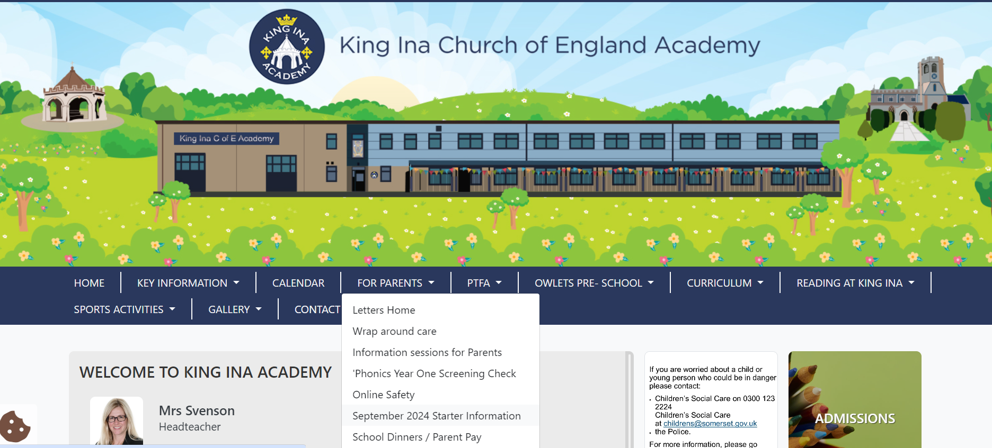
Please see our School Starters Webpage for more information.
https://www.kingina.somerset.sch.uk/web/september_2024_starter_information/663411

Slide 15
If you have any further questions please ask. We are looking forward to welcoming you all to King Ina C of E Academy in September.

